Slide 1
Calculator Project Using Python Developed by [Barsa Prasad]

Slide 2
Self-Introduction
I Am Barsa Prasad, Hailing From Odisha. I Hold A Graduate Degree, Which I Completed In 2017. I have total experience of 5 years as a Senior Associate At Meesho , I am Currently doing Internship at Nexthikes IT Solutions

Slide 3
Introduction Of Calculator
A calculator is an essential tool for performing mathematical calculations, ranging from simple arithmetic operations to complex computations. The Calculator Project aims to design and develop a user-friendly and efficient calculator that can perform various mathematical operations, providing an intuitive interface for users to input and calculate values.

Slide 4
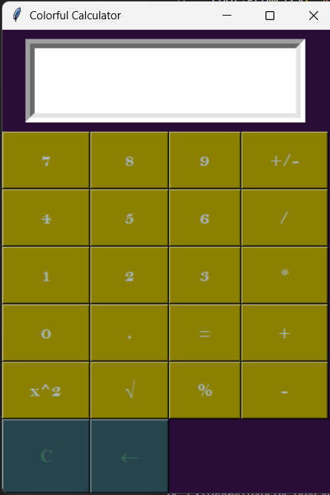
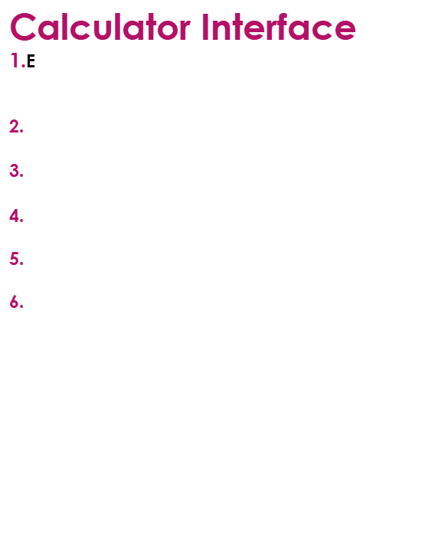
Calculator Interface 1.Entry Field at the top of Calculator to View their calculation Result. 2. Number button (0-9) arranged 3. Operations Button (+, -, *, /, %, +/- , $x^{2}$) 4. Advanced features (exponents, roots etc.) 5. Clear Button ( C ) Is Provided 6. User-friendly interface
User Interface
Key Elements: (Display Screen, Number Pad, Operator Buttons, Clear Button)
Design Considerations: (Layout , Colour Scheme, Typography

Slide 5
Python Libraries 1. Tkinter: Tkinter is Python's de-facto standard GUI (Graphical User Interface) package. It is a thin object-oriented layer on top of Tcl/Tk. In this code, Tkinter is used to create a graphical user interface for a calculator application.

Slide 6
Thank you for your time, and I look forward to your feedback

